Slide 1
Chapter 14
Introduction to Ruby
Programming the World Wide Web
Fourth edition
By Robert W. Sebesta

Slide 2
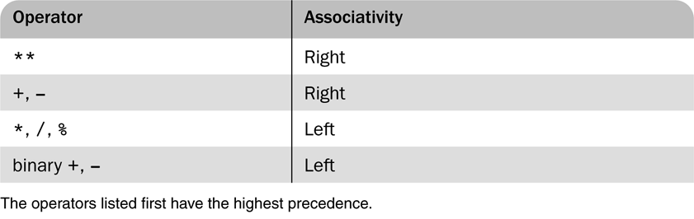
Table 14.1 Precedence and associativity of the numeric operators

Slide 3
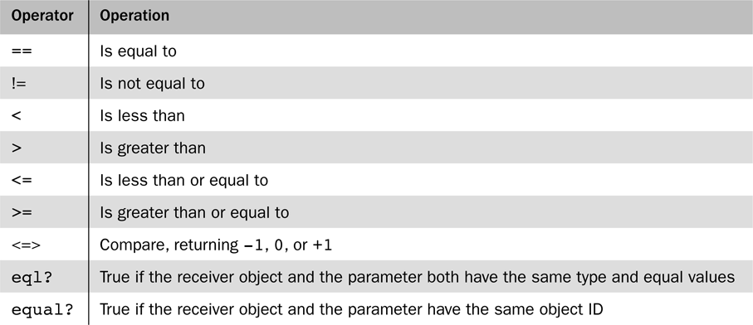
Table 14.2 Relational operators

Slide 4
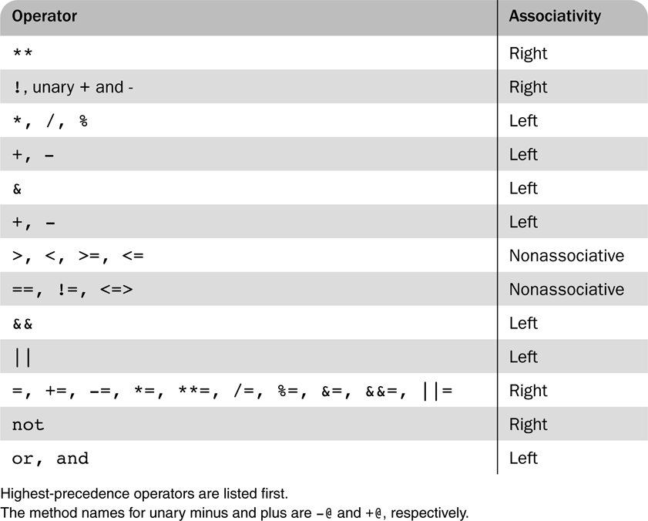
Table 14.3 Operator precedence and associativity

